Slide 1

Linear Discriminant Analysis
it’s just comparing apples to oranges…

Slide 2
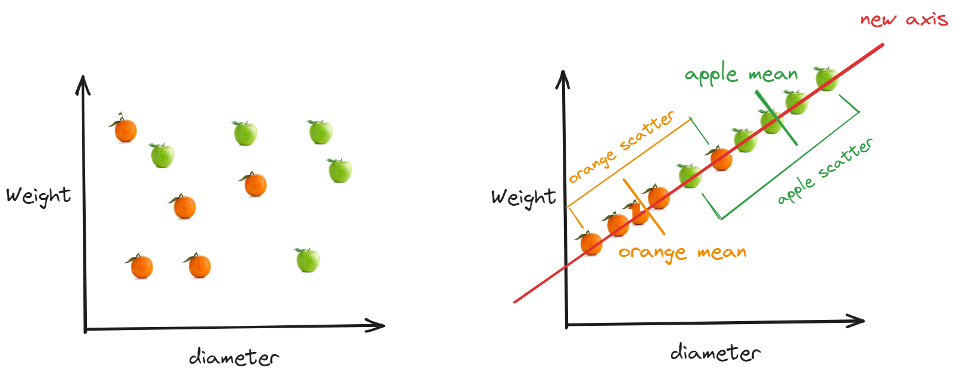
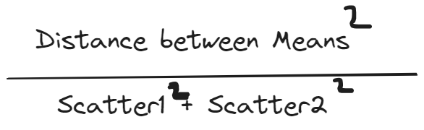
What is Linear Discriminant Analysis?
Supervised Statistical Method for reducing dimensionality and classifying variables in a data set.
Dimensionality
- refers to the number of features or variables in a dataset.
describes the number of dimensions required to describe a data point.
i.e. - for fruit - colour, weight, diameter
discriminant function = coeff0 + coeff 1 * var1 + coeff 2 * var2
Why would we want to reduce dimensionality?
Reducing dimensionality can be beneficial as it helps simplify the data, remove noise or redundant features, and improve computational efficiency.
Notes:
Maximise distance between mean, minimise the scatter

Slide 3
What is Linear Discriminant Analysis?
Strengths
compress the data into a lower-dimensional space, making it easier to visualize and analyse.
can perform classification on more than one class
Weaknesses
- If the relationship is highly nonlinear, LDA may not capture patterns in the data and may result in suboptimal classification.
assumes that the number of samples in each class is roughly equal.
Example:
Medical Diagnostics,
have medical records relating to variables such as clinical measurements such as blood pressure, cholesterol levels, body mass index (BMI) and disease diagnosis.
we can find a linear combination of the clinical measurements that best separates the patients with the disease from those without it.

